Slide 1
Final Presentation on Amazon Reviews
Rushabh, Yash, Isha, Shashwat

Slide 2
Background
Amazon Review Dataset (2018)
Review
Summary
ReviewText
OverallScore
Metadata
About the product itself
Name, features, description

Slide 3
Background
Amazon Review Dataset (2018)
Sorted by categories
Clothing Shoes and Jewelry
Electronics
Toys and Games
Video Games
Size of the dataset
Main is 34 GB
Smaller dataset with 5-core
At least 5 reviews

Slide 4
Problems to Solve
Given a review, predict the overall score
Predict the sales of a product
How helpful is a review is (Helpful, not helpful)
Predict what the type of product is (Sports, Video Games)
Predict multiple categories of a product - Multi Class Labels

Slide 5
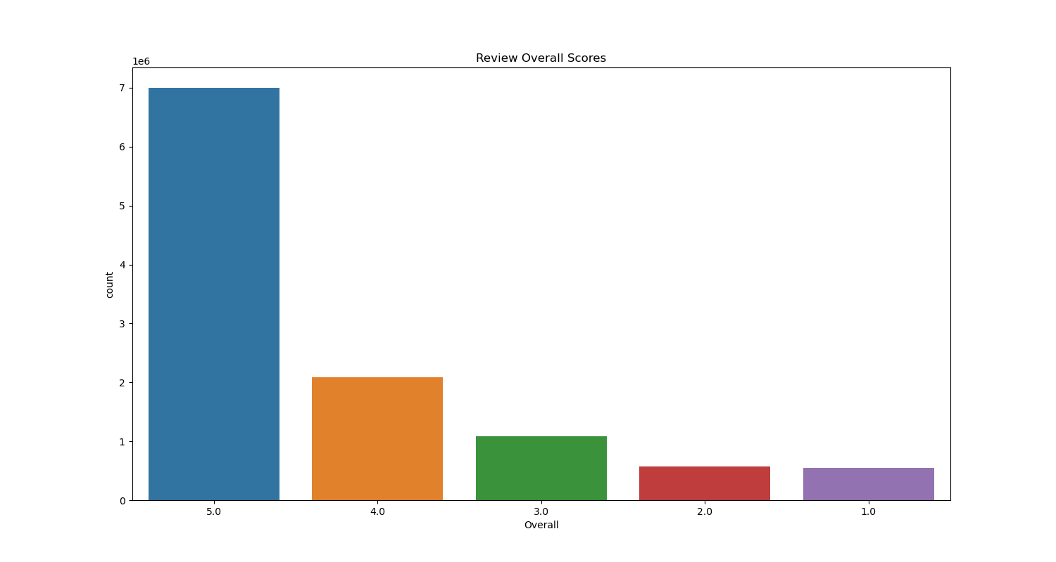
Data Analysis

Slide 6
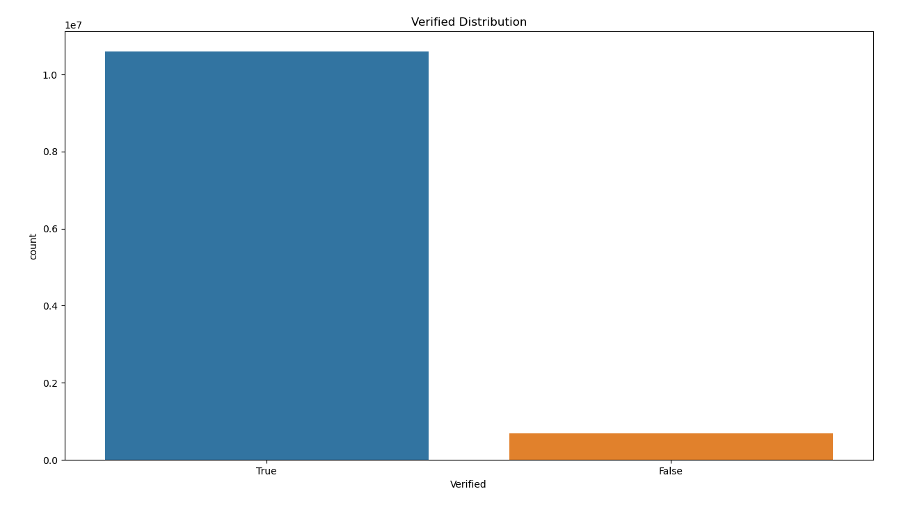
Data Analysis

Slide 7
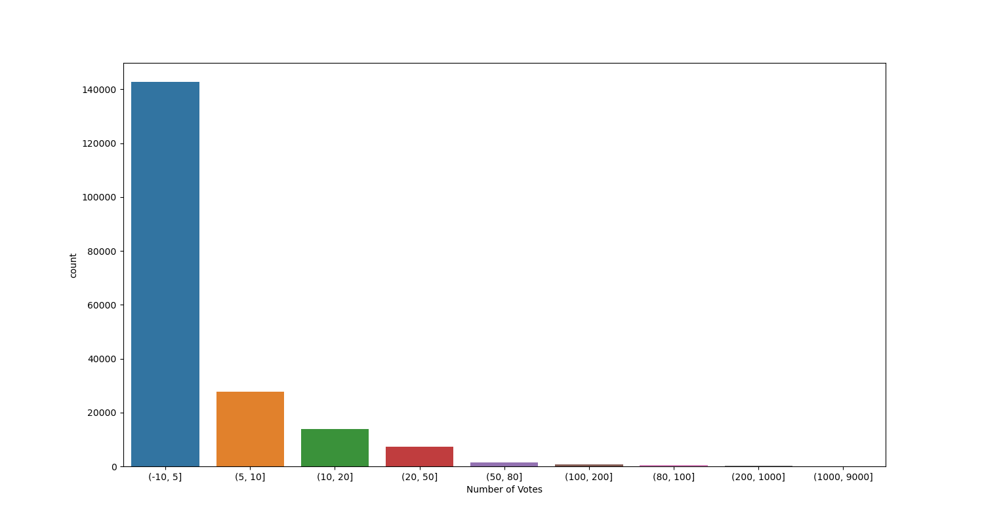
Data Analysis

Slide 8
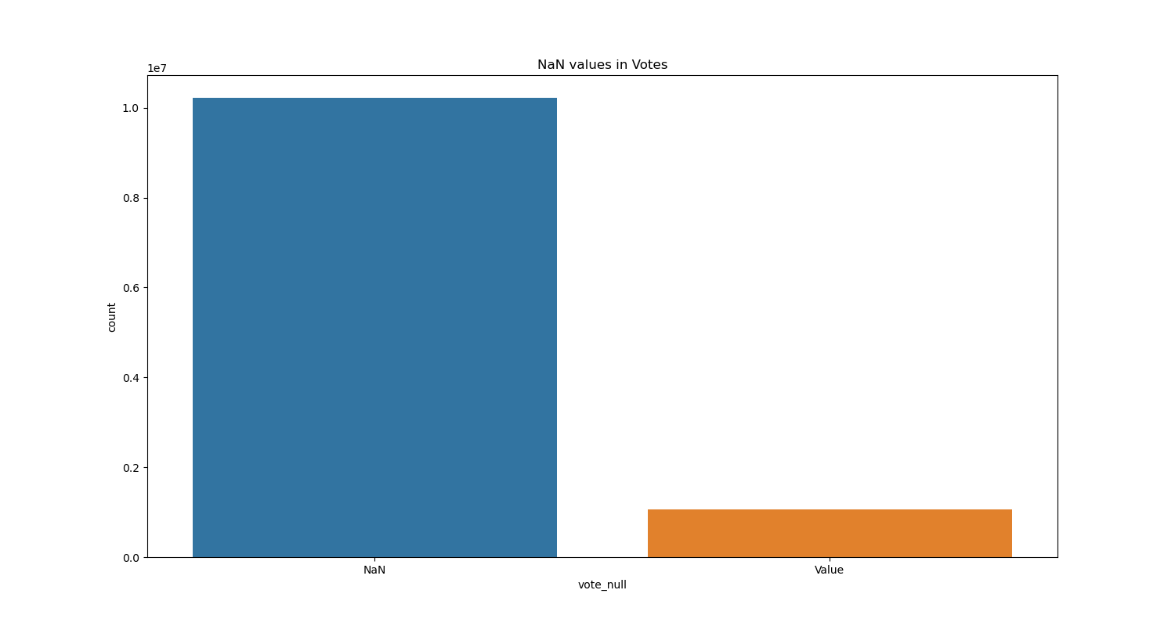
Data Analysis

Slide 9
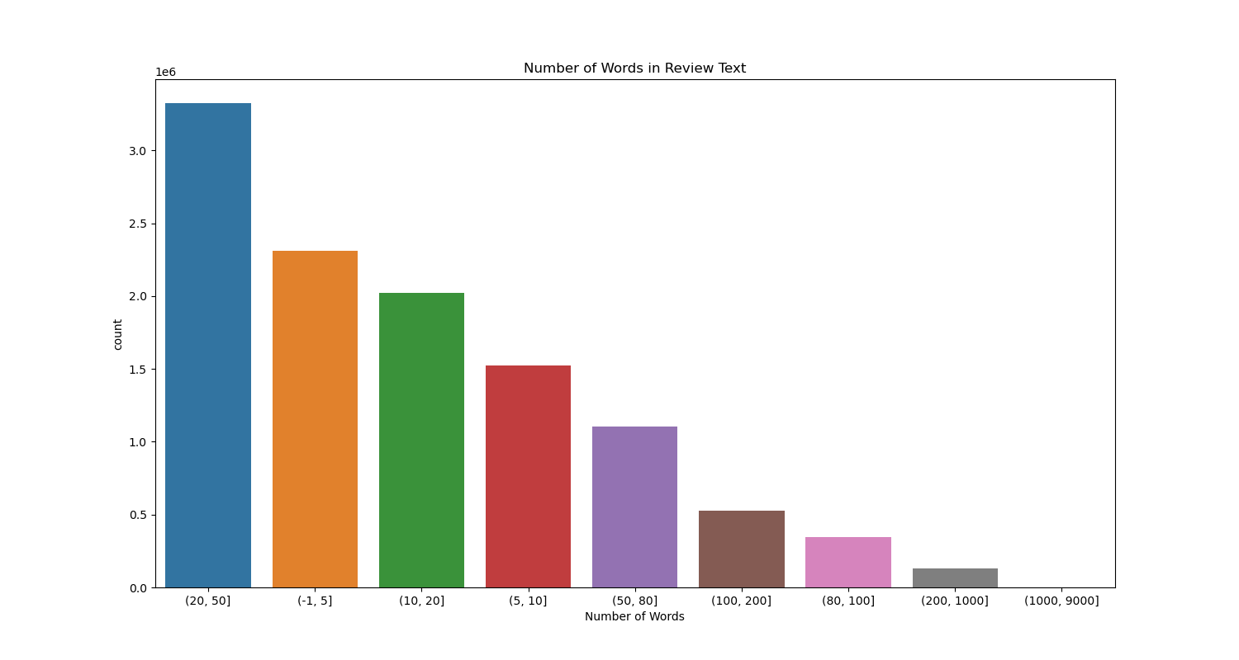
Data Analysis

Slide 10

Data Cleaning
Regular Expression
Tokenizing Words
Removed Stop Words
Lemmatization of Words
Notes:
Why doing TFIDF and data . Explain with visualization.
Regular Expression
Removed Stop Words
Tokenize words
Lemmatization of Words

Slide 11
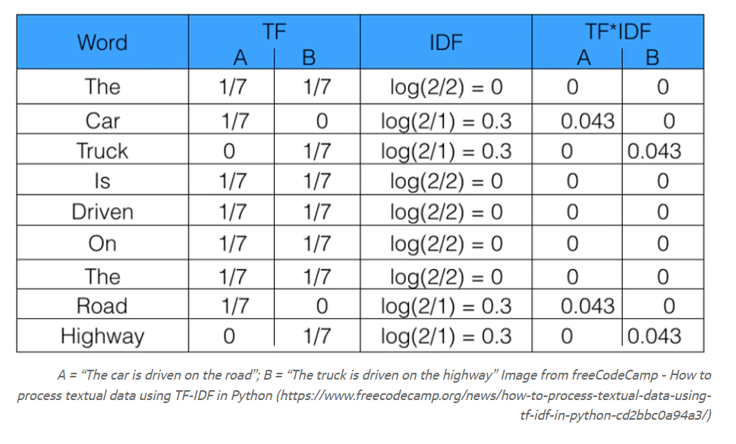
Vectorizing

Slide 12
Classifiers Used and Why
We used 3 classifiers in our project:
AdaBoost Classifier
Random Forest Algorithm
K-Nearest Neighbour
2

Slide 13
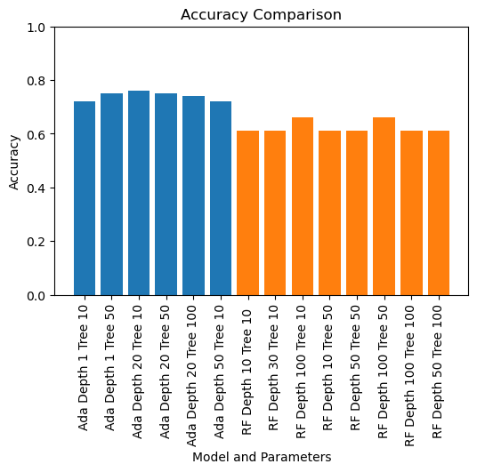
Final Outputs

Slide 14
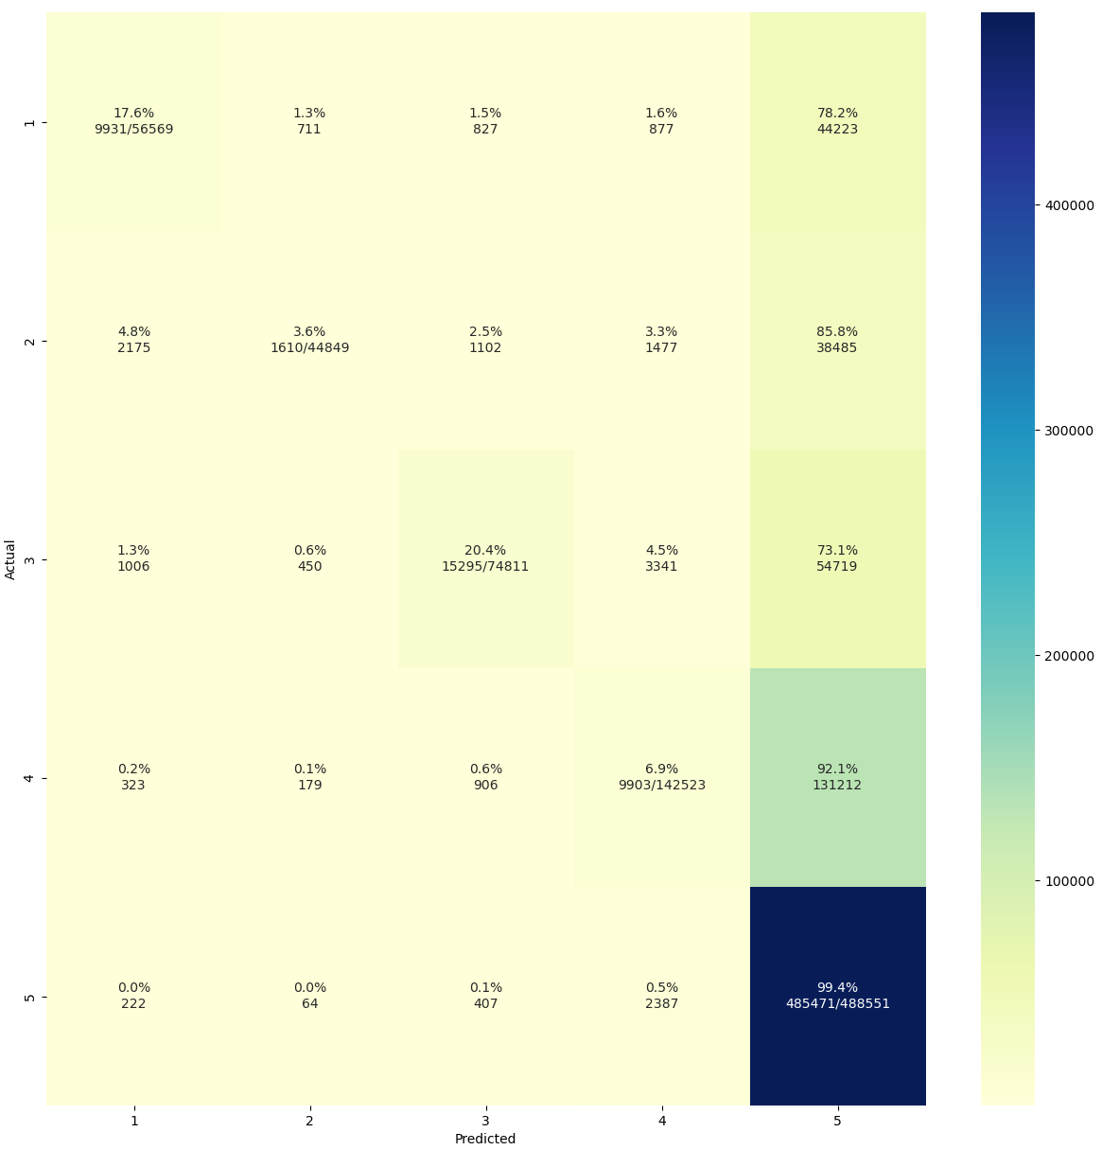
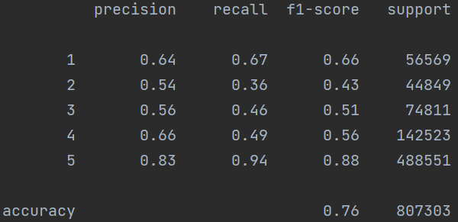
Classification Report of AdaBoost

Slide 15
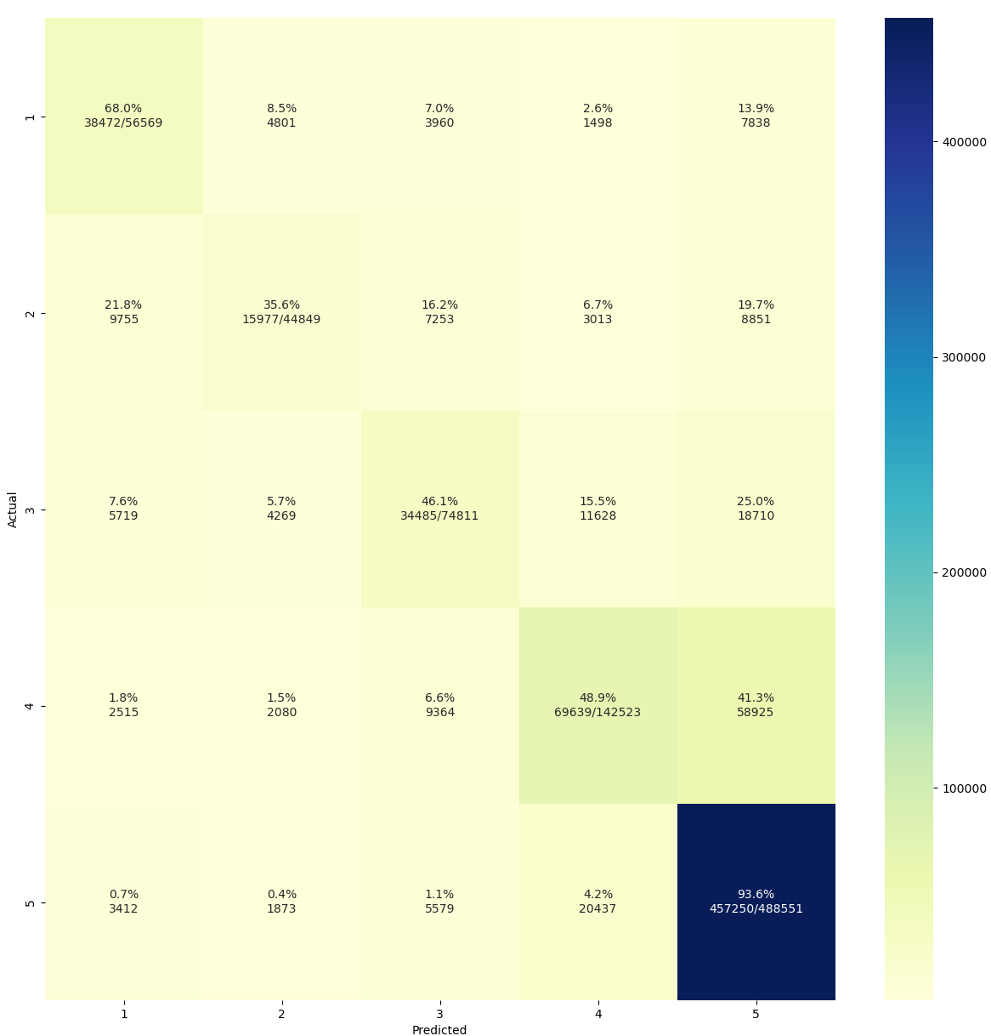
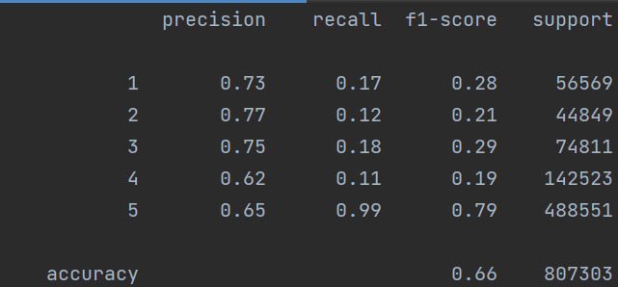
Classification Report of RandomForest

Slide 16
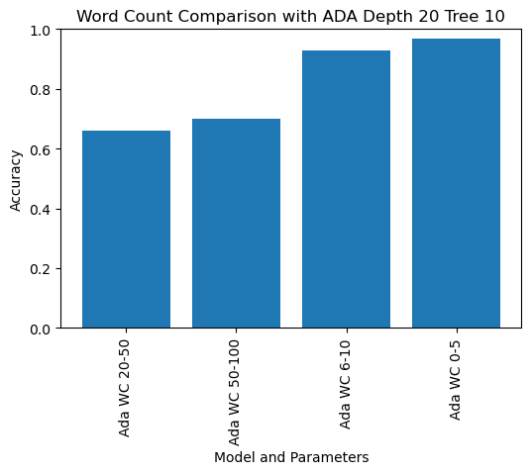
Final Outputs

Slide 17

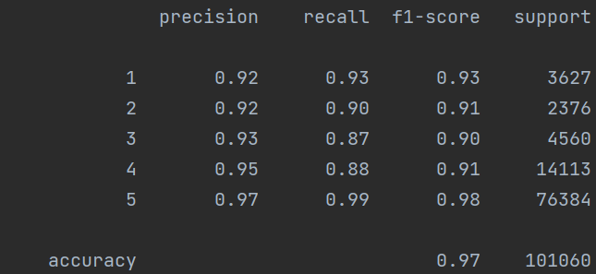
Classification Report of AdaBoost Classifier when word count of ReviewText is 1-5

Slide 18
Challenges Faced
Json -> CSV
Solving “Time Limit Exceeded” error.

Slide 19
Conclusion
Choosing Amazon review Data set and Analysing Problem to Solve
Data Analysis and Data Cleaning
Evaluation of different models and subsets of dataset
Best output with 0.9 F1 score for all classes.

